Slide 1

Welcome to the Hunt
By Tayab Khan

Slide 2
Introduction
The brief was to make a CRUD application using the things we learned in training.
Project Management: I used Jira, a fully expanded board with 2 sprints.
Version Control System: Github, easier to work with and user friendly.
Database: I used mySQL, which updates at midnight, something I found out in a way I didn't want to.
Java SE and Spring Boot: created application in Java and used Springboot to bring it to life.
Testing: Tried to get at least 80% test coverage using Junit and MockMVC.
Front-end development: Visual Studio Code, with a javascript that worked as an API and a CSS to make it look nice.

Slide 3
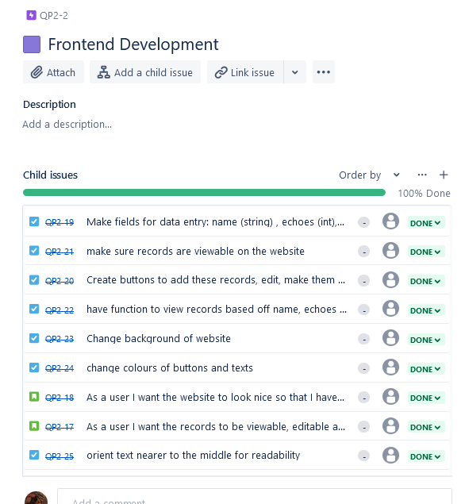
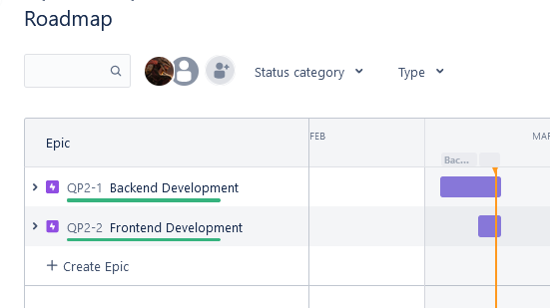
Planning: Jira

Slide 4
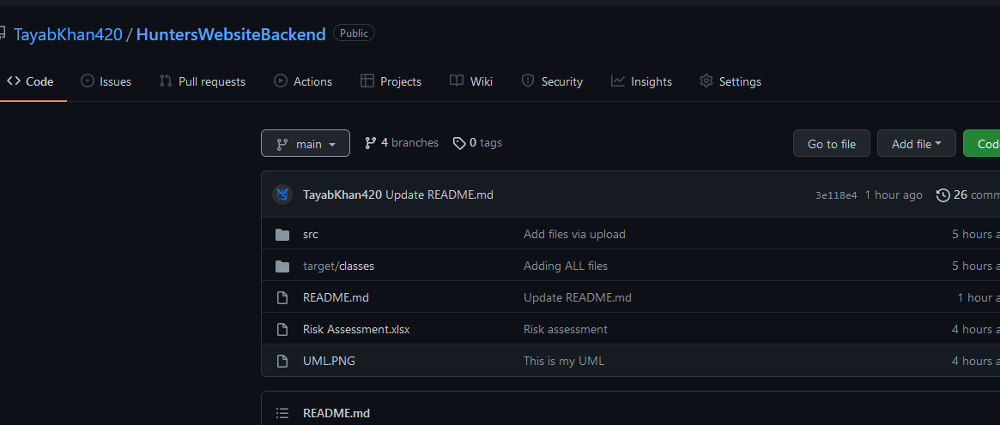
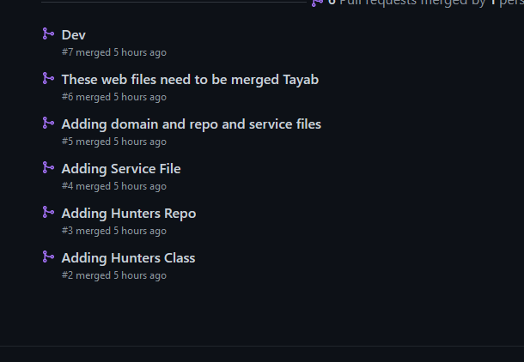
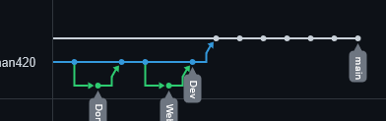
VCS: Github

Slide 5

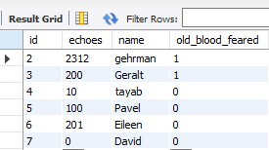
Database: mySQL

Slide 6

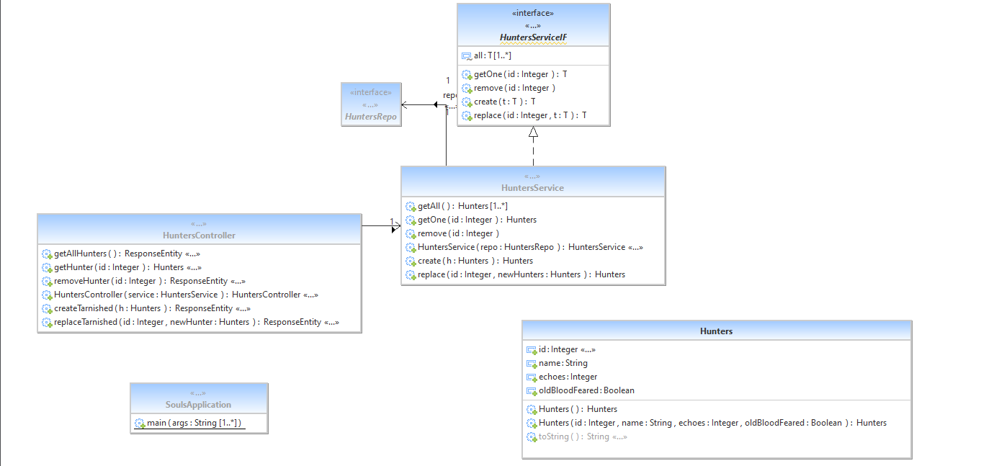

Java and Springboot

Slide 7
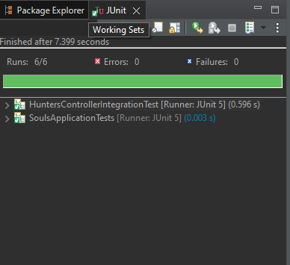
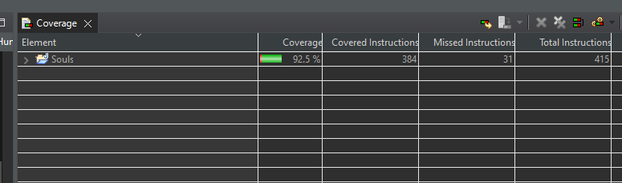
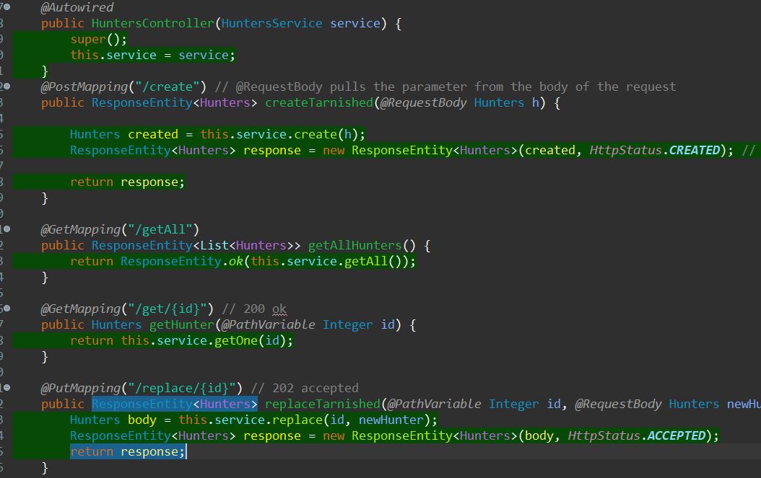
Testing: MockMVC

Slide 8
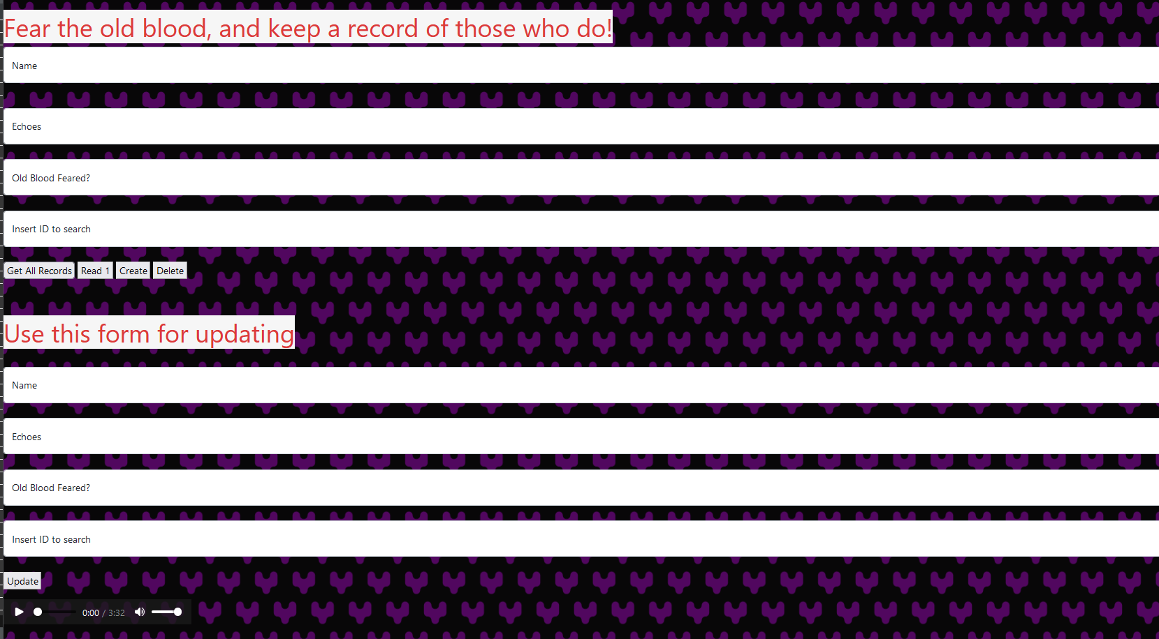
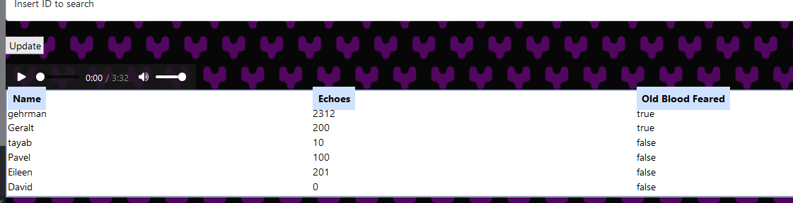
FrontEnd: HTML, JS and CSS

Slide 9
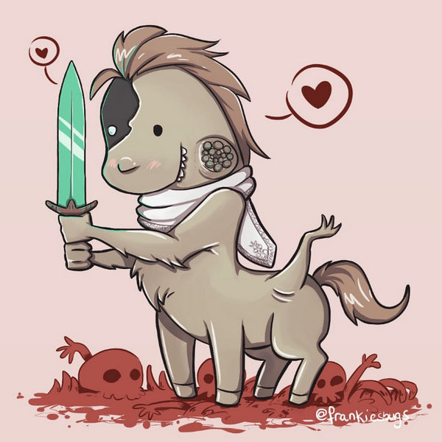
Thanks for watching!

